Slide 1
Single Queue Guided Projects Training

Slide 2
Benefits of Guided Projects
Provides a guide to choose the right requests for the project, removing the guess work, and you no longer need to use Excel checklists.
Improves project planning via the Project Request Planner.
Improves request menu interface, now including both Requests and Projects.
Improves functional team views of incoming work, avoiding last minute requests and escalations.
Displays the progression of opening requests and required approvals.
Improves date visibility by displaying project phasing, SLAs, and calculated end dates.
Improves project saving capabilities.
Establishes a platform to build and update guided projects in the future without IT.

Slide 3
Agenda
What has changed?
New Request Pop Up
Request/Task Dashboard Updates
Request Form Updates
New Project Form UI
What happens to the existing projects?
Project Taxonomy
Date Recalculating Triggers
Ways to save a project
Non Guided Project
How to add a project
How to add new and existing requests
Guided Project
How to add a project
How to add new and existing requests
Set Phase Date
Early Start/Late Start

Slide 4
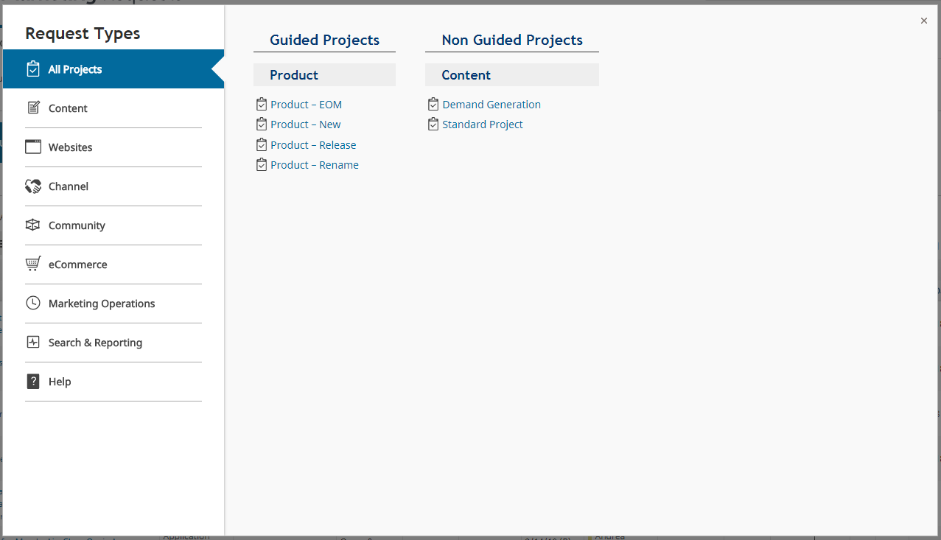
New Request Pop Up
Redesigned the request pop up to simplify and unclutter the menu. This will improve navigation and user experience.
Displays both project and request types
Moved Websites, Channel and Community requests to their own tab
Hid project specific request types from the menu

Slide 5
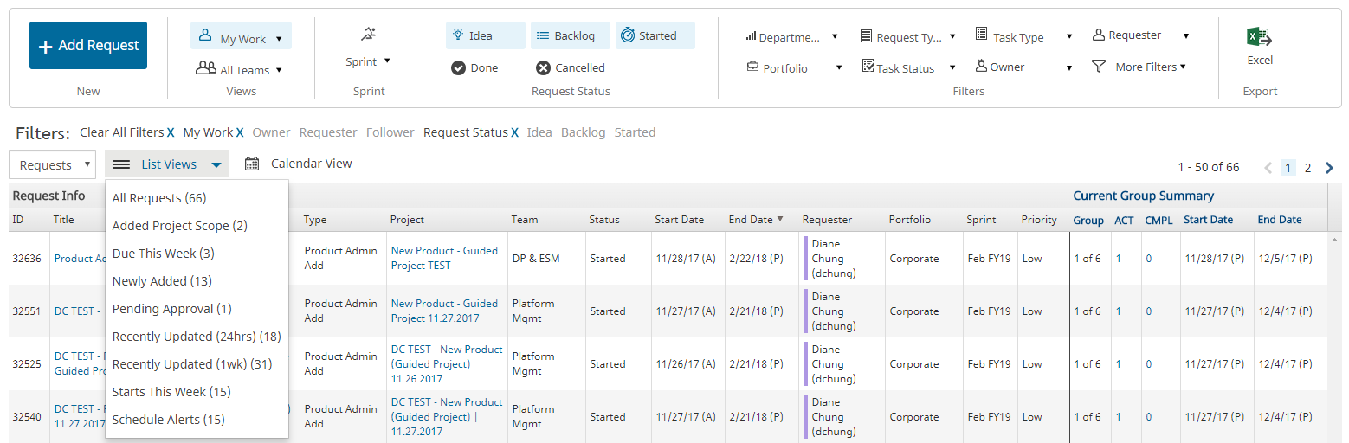
Request / Task Dashboard Updates
New List View Filters:
Added Project Scope : Requests which have been added to a project that has either been Started or Backlogged. These type of requests are identified with an APS badge.
Due this week : Requests which are scheduled to be due in the week.
Newly Added : Requests which have been added within the last 24 hrs and have the NEW badge.
Pending Approval : Requests which are pending some sort of action
Recently Updated (24hrs) : Requests which have been updated within the past 24hrs
Recently Updated (1wk) : Requests which have been updated within the past week
Starts This Week : Requests which are starting this week
Scheduled Alerts : Requests which are past due or out of sprint

Slide 6
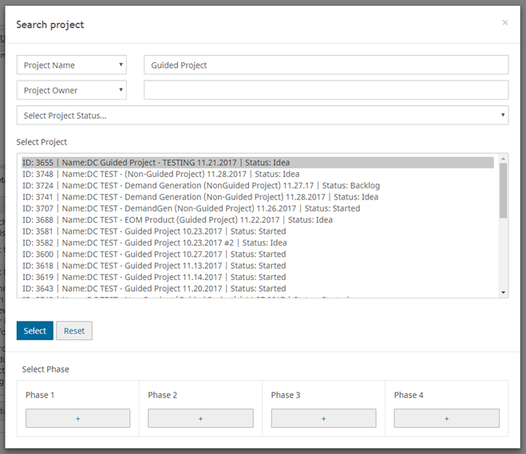
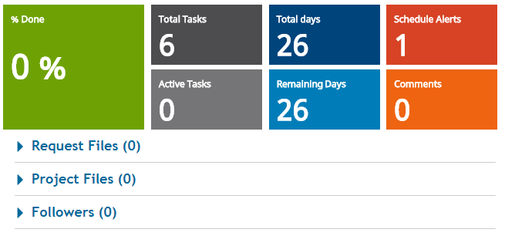
Request Form Updates
Associating a project to a request, user will need to select a Phase. (Phase to be explained in future slides)
Associated projects are now hyperlinked so users can easily access the project.
Project files are visible among associated requests and vice versa

Slide 7
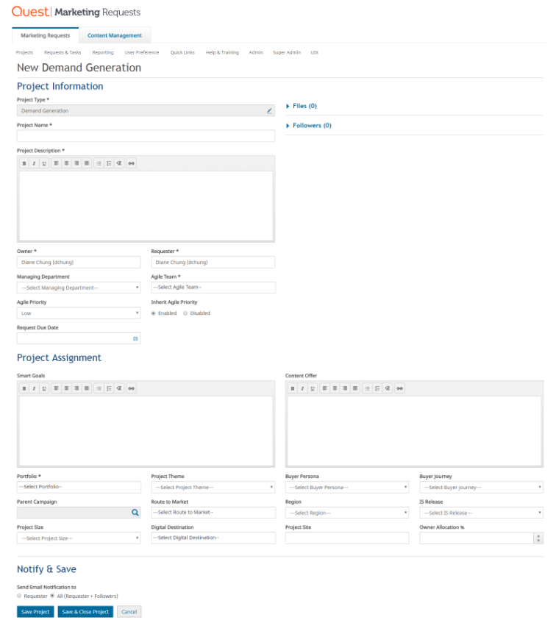
Adding a project
1
4
Project Information
Project Assignment
Notify & Save
Files & Followers
2
3

Slide 8
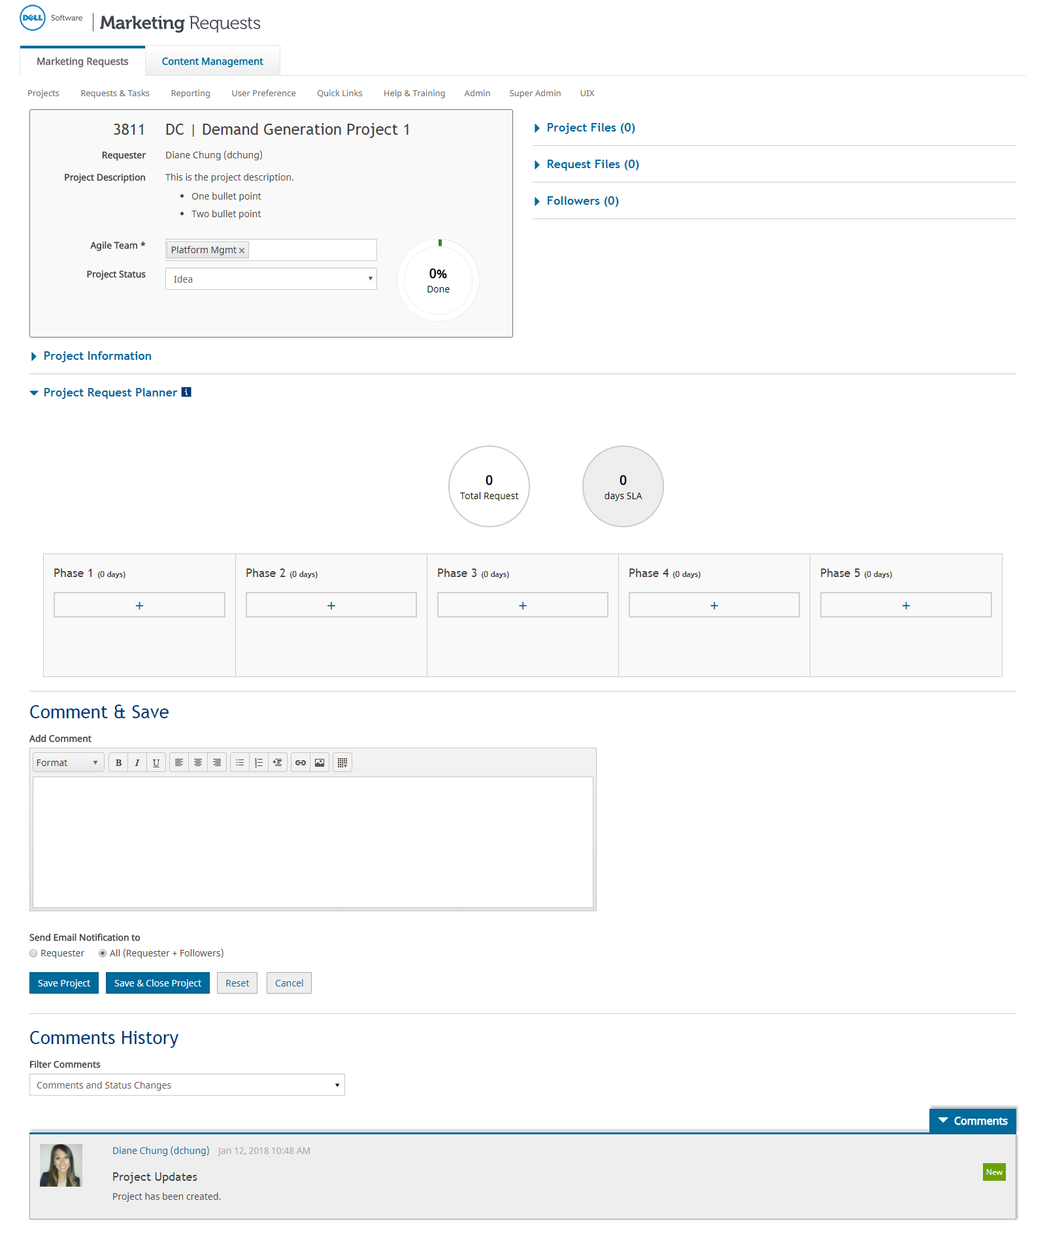
Editing a project
1
6
Project Overview
Project Information
Project Request Planner
Comment & Save
Comments History
Files & Followers
2
3
4
5

Slide 9
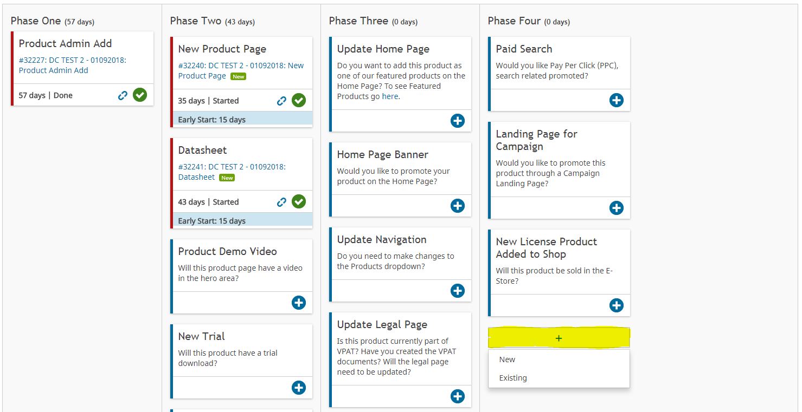
Adding a request to a project
Under the Project Request Planner, each phase has an add button, upon click, you can select New or Existing.
New: Triggers the request type pop-up to appear to select a request type
Existing: Triggers a pop-up to select requests which have already been created in the system
Note: A phase is closed when the system date is greater than the greatest actual end date of the requests of that phase. If the phase is closed, the add button will not appear for that phase. For example, Phase 1 does not have an add button.

Slide 10
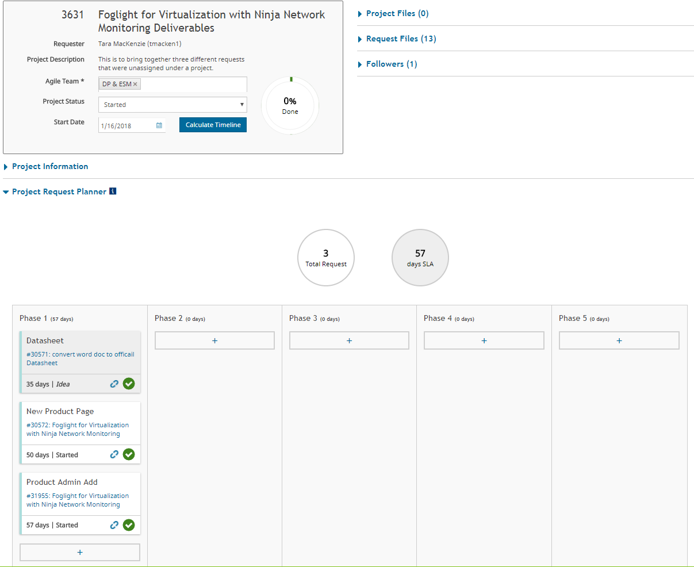
What will happen to my existing projects?
All existing projects will get migrated over to the new non-guided UI.
IF your project has a current Start Date, we migrated that over. To calculate the project end date, you will have to hit the Calculate Timeline button.
Project Status will remain as is until updated.
All requests will appear in Phase 1.

Slide 11
Project Taxonomy
Project ➔ | Phase (1:M) ➔ | Request (1:M) ➔ | Group (1:M) ➔ | Task (1:M)
PROJECT | PHASE1 | REQUEST1 | GROUP1 | TASK1 TASK2
 |  |  | GROUP2 | TASK1 TASK2
 | PHASE2 | REQUEST1 | GROUP1 | TASK1 TASK2 TASK3
 |  | REQUEST2 | GROUP1 | TASK1 TASK2
 |  | REQUEST3 | GROUP1 | TASK1 TASK2
The three main entities of Single Queue are Project, Request and Tasks. With guided projects, we are introducing a new concept called Phase.
A project can have multiple phases
Each phase can have multiple requests
Each request can include multiple groups
Each group can include one or more tasks

Slide 12
What are the different project statuses?
Project Status | Description
Idea | Project has been created and accepted by the system
Started | Project is being worked on
Backlog | Project has been accepted and project is set to be worked on at a later date
Cancelled | Project has been cancelled
Done | Project is complete
Note:
All projects have to be manually Started unless defined otherwise at project admin level.
A guided project can only be Started when all REQUIRED requests have been created.
When a project is moved from Idea to Backlog or Started, all requests in Idea will automatically flip to Backlog. This is only applicable if defined at the project admin level.

Slide 13
What triggers date recalculation?
Date recalculation will adjust the dates of your requests and tasks based on the associated project. Below are the triggers for date recalculation:
When a request is added to a phase
When a request is removed from a phase
When a request is being moved to another phase
When the Planned End Date at the request level is changed causing the request end date to change
When a request is cancelled
When a request is done
When a task is cancelled or added to a request
Note: Started request dates & manually updated Backlog request dates will not be recalculated.

Slide 14
Ways to save your project
In previous project module, there was only way to save your bulk change and that was through the blue SAVE button.
Moving forward, based on the update that is made to the project, associated requests and tasks will be updated accordingly. The system will update your project, request dates and statuses as needed. Below are the functions that will save your project:
Hitting the Calculate Timeline Button
Associating a new or existing request
Unlinking a request
Adding or deleting files
Moving a card
Hitting the Save and Save & Close Project Button

Slide 15
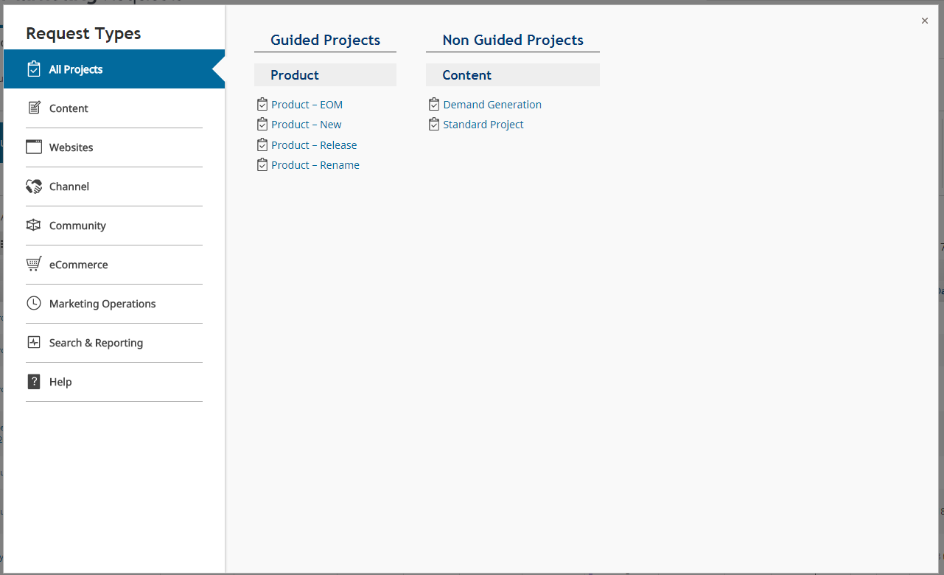
Let’s add a non-guided project
Add a Demand Generation project

Slide 16
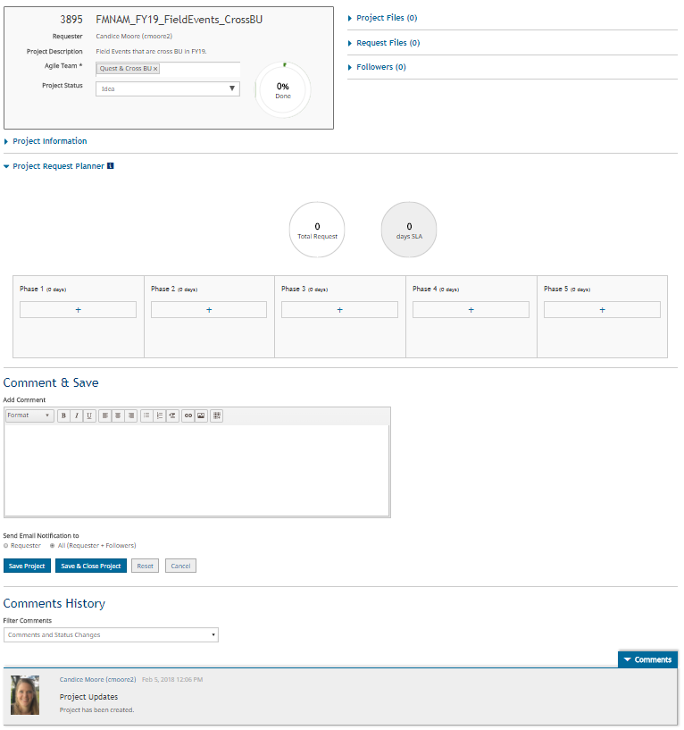
Demand Generation project
Added a project
Project is set to Idea status
There are five empty phases

Slide 17
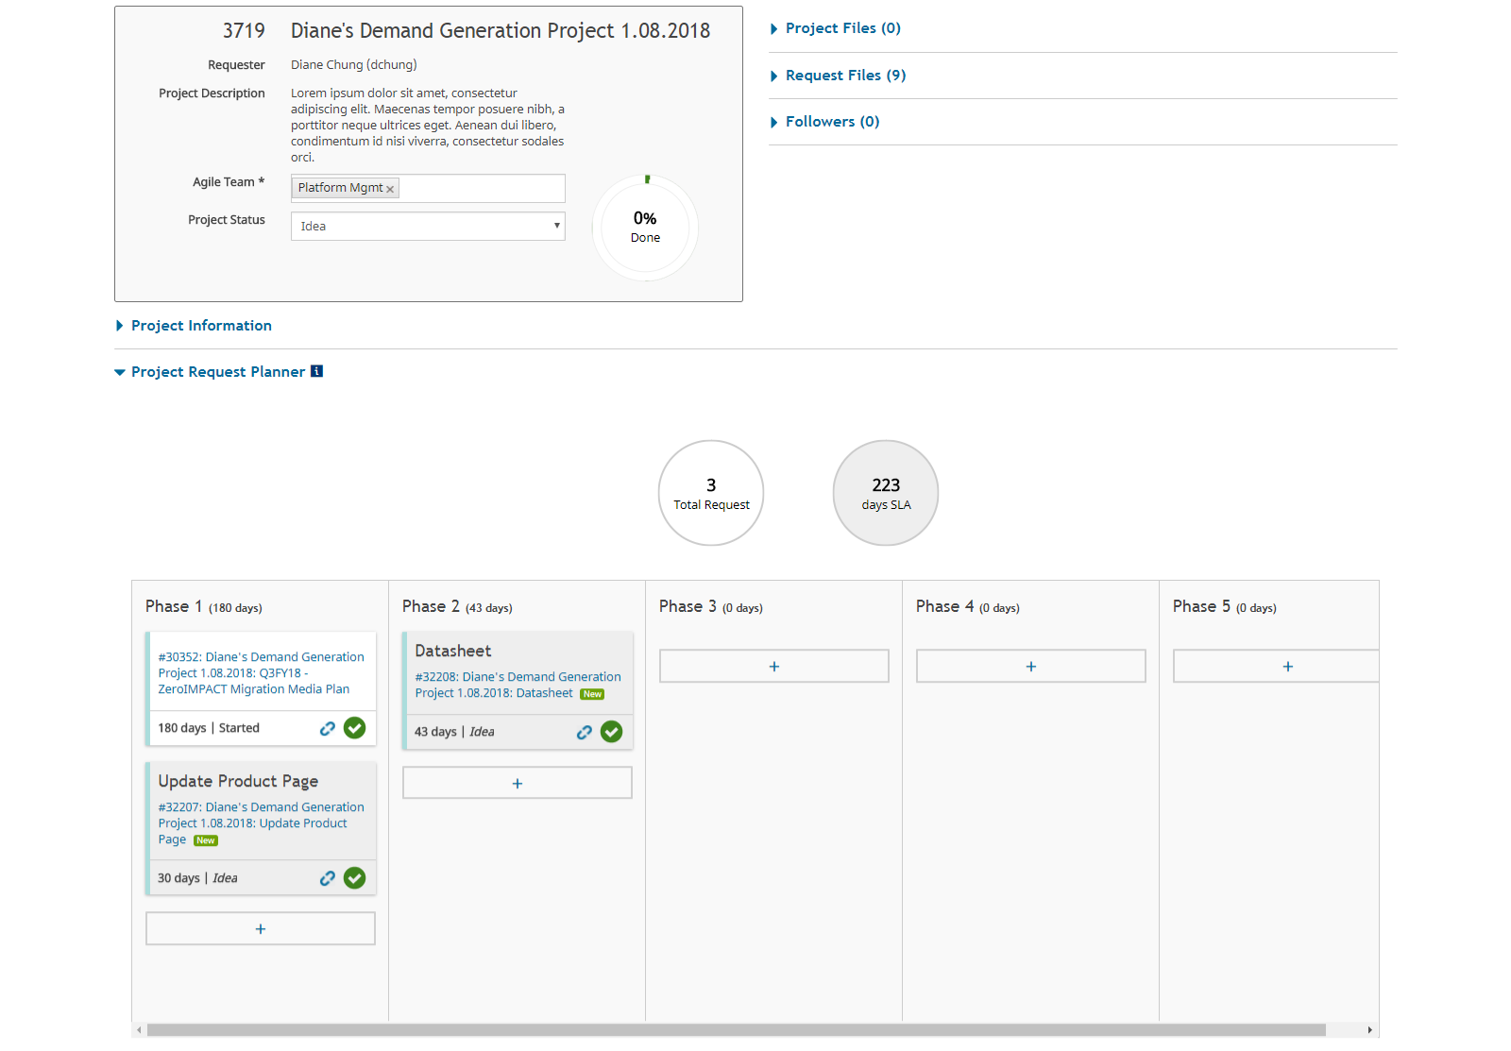
Add requests to the project
Added two new requests
One request in Phase 1
One request in Phase 2
Both requests are in Idea status
Added one existing request
One existing request in Phase 1.
Request is in Started status
Note: By associating requests (new/existing) the request title automatically inherits the project title. System will prefix the request title with the project name.

Slide 18
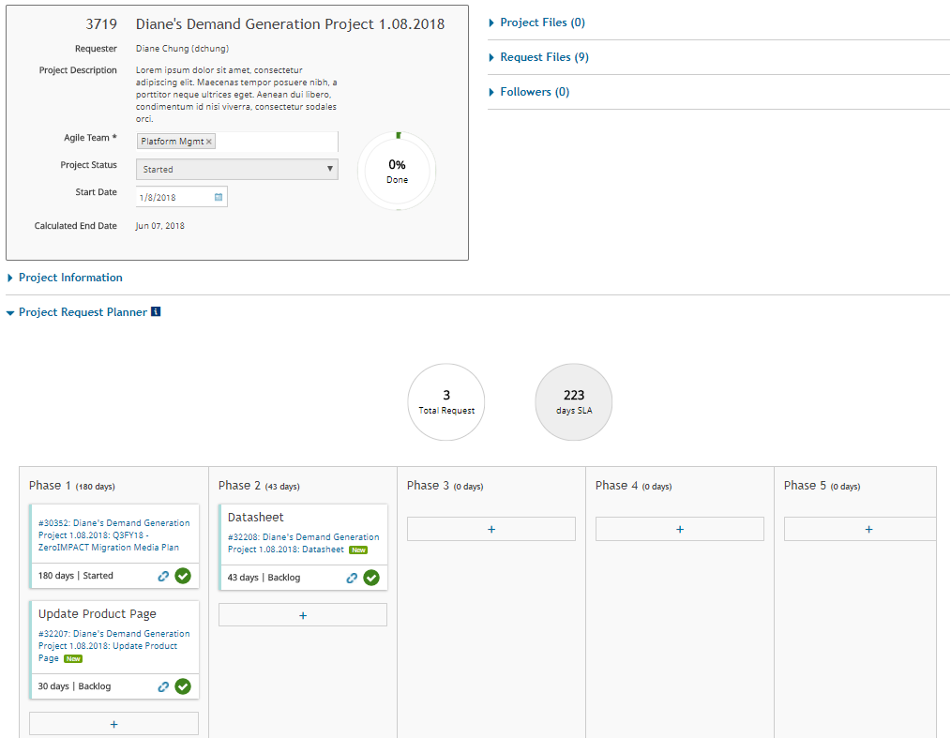
Start the project
Started the project on 1/8
Clicked the Calculate Timeline button
Calculated End Date appears
Idea requests automatically update to Backlog requests (if applicable)
Lets work the requests
Note: Started request dates & manually updated Backlog request dates will not be recalculated.

Slide 19
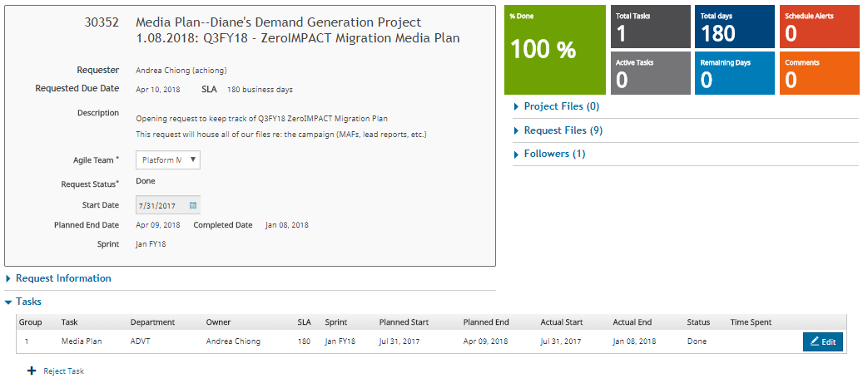
Complete Media Plan request associated to project
Andrea started the request on 7/31/17
Andrea marked her task Done on 1/8
Request is marked Done 1/8

Slide 20
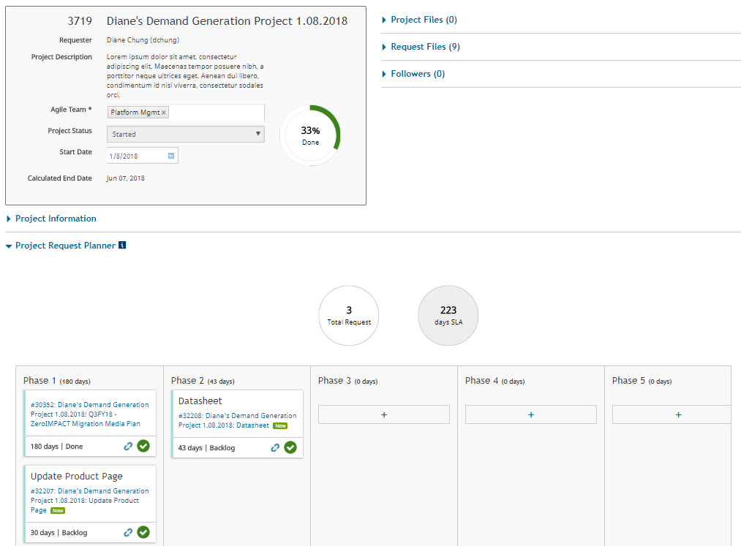
Return back to the project
Media Plan request is marked Done
Project is 33% Done
Calculated End Date will update based on the request activity
Proceed to complete the remaining requests

Slide 21
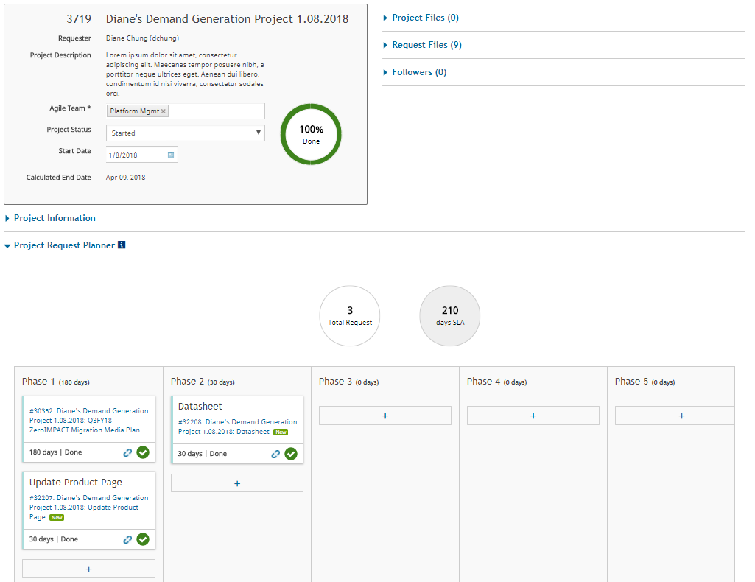
Return back to the project
Update Product Page and Datasheet requests have been marked Done
Phases 1 and 2 complete.
Project is 100% Done
Project is still at Started until user marks it Done.

Slide 22
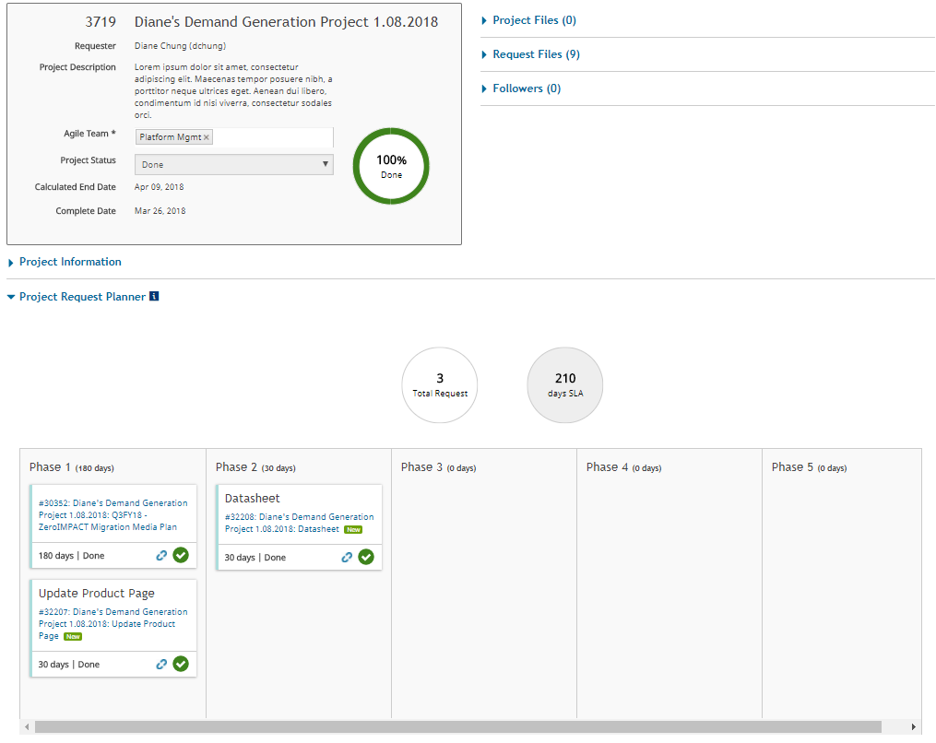
Complete the project
Moved project from Started to Done
Completed Date is 3/26

Slide 23

Let’s add a guided project
Add a New Product project

Slide 24
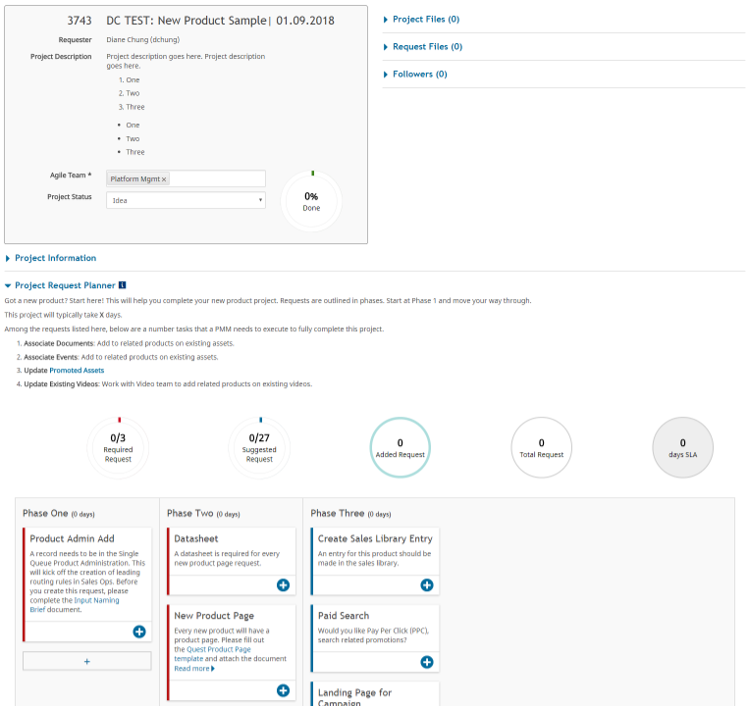
New Product project
Added a project
Project is set to Idea status
There are three phases with pre-defined request types (required/suggested)

Slide 25
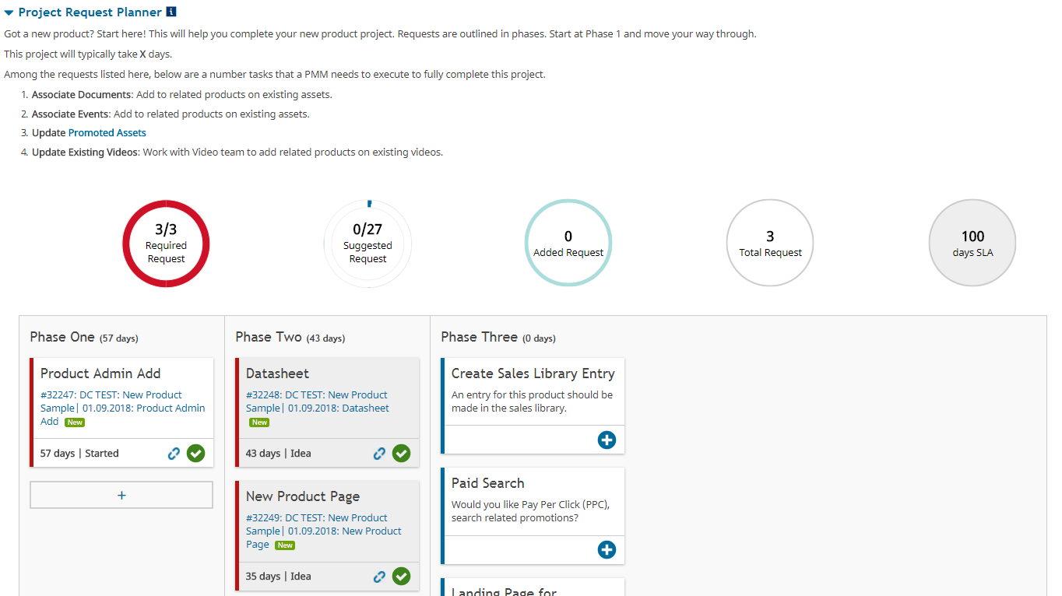
Add requests to the project
Created all required requests
Required requests consist of the following:
Product Admin Add
New Datasheet
New Product Page

Slide 26
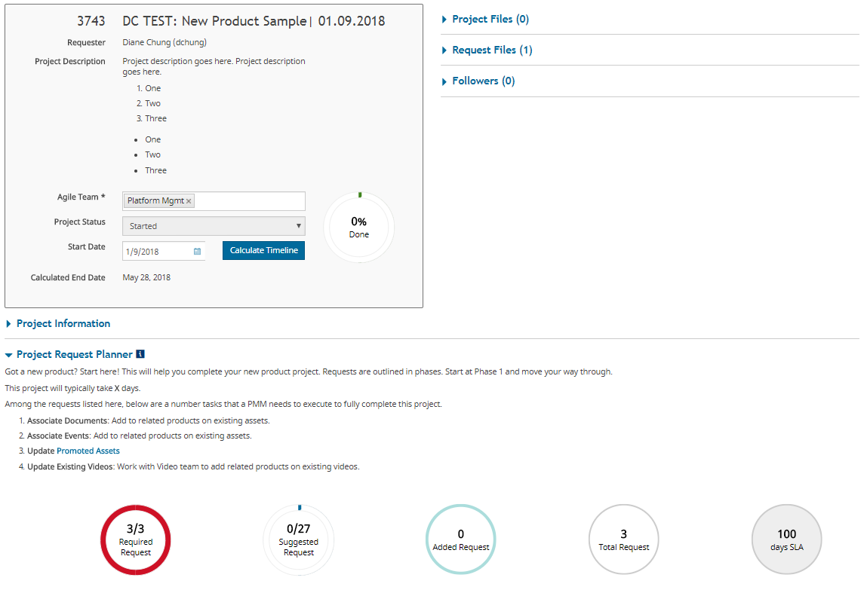
Start the project
Started the project on 1/9
Click the Calculate Timeline button
Calculated End Date appears
Idea requests automatically update to Backlog requests
Lets work the requests

Slide 27
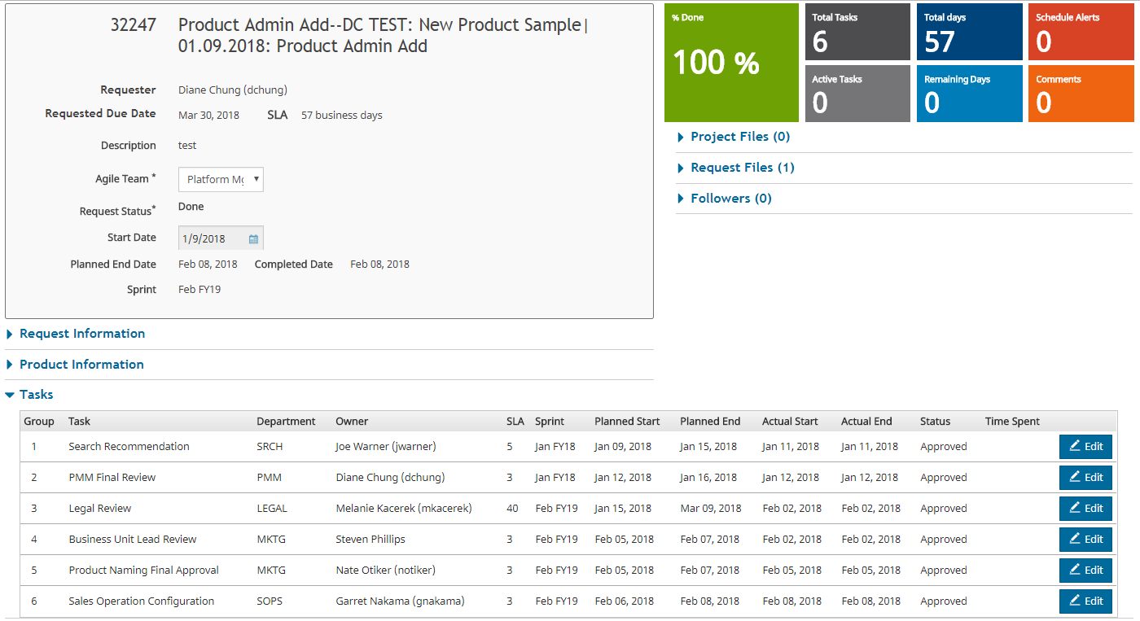
Complete Product Admin Add request associated to the project
Started the request on 1/9
Joe marked his task Approved on 1/11
Diane marked her task Approved on 1/12
Melanie marked her task Approved on 2/2
Steven marked his task Approved on 2/2
Nate marked his task Approved 2/5
Garret marked his task Approved 2/8 and completes the request
Request is marked Done 2/8

Slide 28
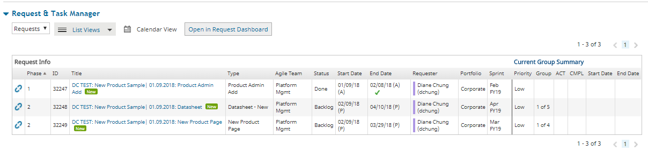
Completing the project
Phase 1 request is marked Done.
Phase 2 requests are sitting in Backlog with adjusted planned end dates
Once both requests in Phase 2 are marked Done, user can complete the project by moving it from Started to Done

Slide 29
Set Phase Date
This functionality will only appear for a project where there is an ability to calculate the timeline. This flag is set at the Project type Admin. This is how it will work:
When user moves the Project to Started of Backlog, show the Start Date field along with the phases that are allowed to be overridden.
The Phases in which can be set, will appear with radio buttons, options of Yes or No. Default is No.
Yes
If Yes is selected, provide a date selector box to defined a start date of the phase. No Default date at the time. Note: Error Message: Phase Date cannot be in the past.
No
If No is selected, we will use the default date once the project timeline has been calculated.
Once the user is done with setting the dates, user is to hit the Calculate Timeline button
Once the Calculate Timeline button has been hit, we are to provide the user with the Calculated End Date
At any time, the user can go back and update the dates above. Once they have manually updated the dates, we shall honor those dates.
At any time, the user can choose to go back to the default dates, we will look at the phase and apply recalculation based on the greatest actual end date of the previous phase. If actual date is not present, we are to use the greatest planned end date.

Slide 30
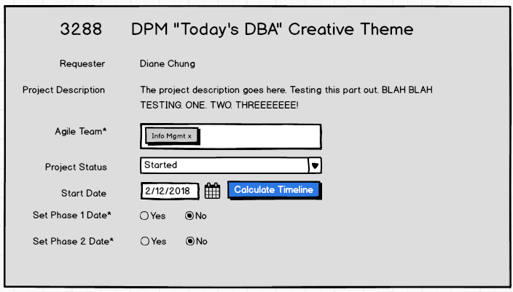
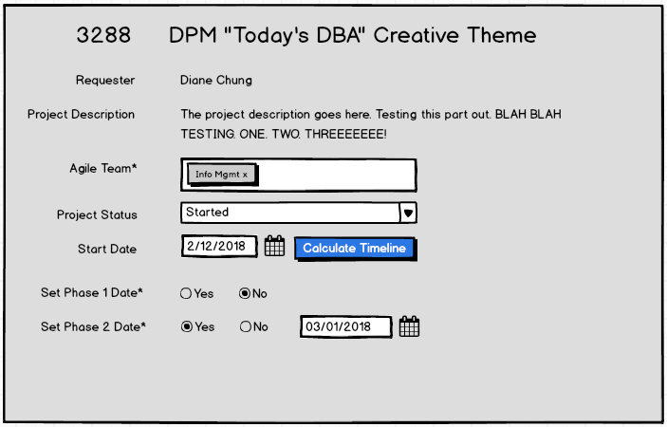
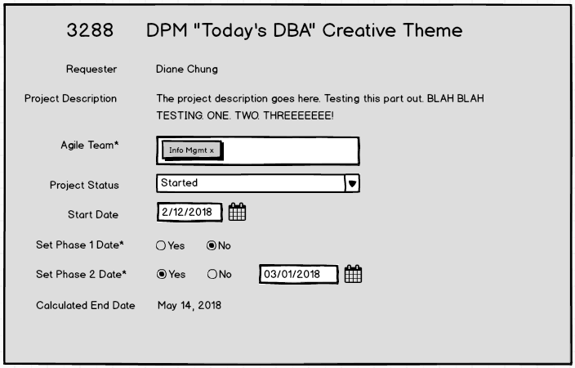
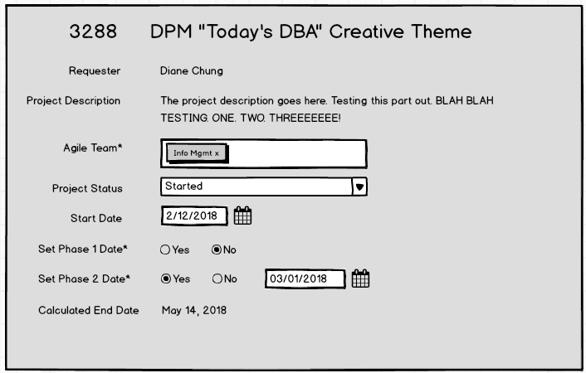
Set Phase Date (continued)
Step 1: Setting the Project Status to Started or Backlog. Start Date (Defaults to system current date), Calculate Timeline button, Phase selection will appear.
Step 2: Start Date editable. User can choose to select a start date for the phases by selecting Yes. Once user chooses yes, they are to select a date for that phase, date selector is empty at the time of load.
Step 3: Hit the Calculate Timeline button to see the Calculated End Date of the project.
Step 4: If user adjusts any of the dates, we are to show the Calculate Timeline button again. For example, if the user changes from Yes to No OR No to Yes, we are to show the Calculate Timeline button.

Slide 31
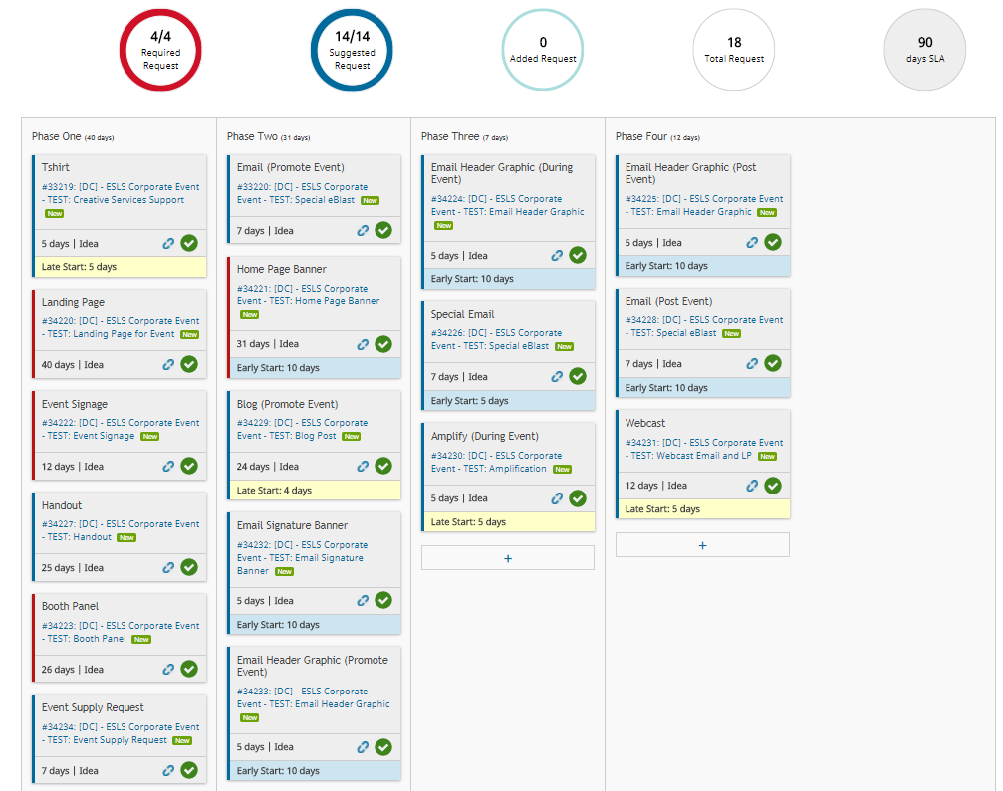
Early Start/Late Start
This functionality is defined at the project type level and is available for Guided Projects only. Users have the ability to define if a request should start earlier or later that the system calculated date. Number of days can be defined as well.
This function will be used to stagger and streamline work in the same phase.
Examples:
Early Start of 5 days: User can start a request 5 days before the planned/actual end date of the previous phase.
Late Start of 5 days: User can start a request 5 days after the planned/actual end date of the previous phase..

Slide 32
Questions?

Slide 33
Appendix
Requested Due Date
Currently, this field is called Due Date
Moving forward, this field will be called Requested Due Date
This field will throw an error when user inputs a past date
Error Message : “Request Due Date cannot be in the past”
Project Start Date
Currently, this field is called Start Date
Moving forward, this field will be called Project Start Date
This field will appear when user moves a project to Started or Backlog
Calculated End Date
Currently this field does not exist
Moving forward, the system is to take the greatest Planned End Date of the requests and display
Completed Date
When all requests associated to the project are marked Done/Cancelled, project is to be stamped with a completed date. If users add additional requests, completed date is to recalculate.

